Slide 1
Collaborative Forum on Global Innovation January 7-8 2011
International Business Center, Joseph M. Katz School of Business Echo Strategies

Slide 2
Global CTO Panel January 7th, 2011 Connecting Thought Worlds: Research and Practice
Eric Kelusky, NovaChemicals; Chuck Kahle, Global CTO PPG, John Goossen, Director Nuclear Innovation Westinghouse; Bob Kumpf, CAO,Bayer

Slide 3
Dr. Susan Cohen

Slide 4
Lou Musante

Slide 5
Leah Silverman

Slide 7
Does Location Still Matter for R&D?
Dr. Kevin Stolarick – Yes it Does!
vs.
Bob Evans – No it Doesn’t!

Slide 9
Does Location Still Matter for R&D?
Answer: It depends on what we mean by R&D
On whether we focus on invention (mega-regions produce more patents) or commercialization (we don’t know – though GDP relationship is suggestive)
But, perhaps we should consider what we mean by R&D?
Do we consider the gathering of fine-grained customer data (e.g. via Coke’s Freestyle soda dispenser, or the Build-A-Bear experience) or enabling a novel customer relationship (e.g. Abercrombie’s virtual runways via RFID + loyalty card) to be Research, or Development? Is R the customer insight behind these product ideas, or is this D? How did recognition of the potential to combine technologies and enable these functions occur?

Slide 10
Mechanisms and Institutions Shaping Regional Knowledge Flows
Dr. Bo Carlsson
Dr. Zhao Gang

Slide 11
Dr. Bo Carlsson

Slide 12
Dr. Zhao Gang

Slide 14
Does Location Still Matter for R&D?
Answer: It depends on what we mean by Location and What role we want to play in that location.
Geographic clusters tend to be discovery-driven or design-driven. Locating in the former provides access to knowledge spillovers and the opportunity to influence the architecture of solutions, and match solutions to problems. Locating in the latter guarantees neither as knowledge tends to flow into the region via market mediated technology transfers, and established hubs play the role of the architect.
Countries differ greatly in how their national institutions and culture affect the workings of geographic clusters. China’s efforts to bolster basic research and invest in innovation cities is a top down approach to stimulating entrepreneurship that seems to hold the potential to create clusters that are a hybrid of the discovery vs. design driven prototypes.

Slide 15
Locating and Facilitating Inter-organizational Collaboration, Globally
Dr. Mier Zhang
Dr. Lilach Nachum

Slide 16
Dr. Lilach Nachum

Slide 17
Dr. Mier Zhang

Slide 18
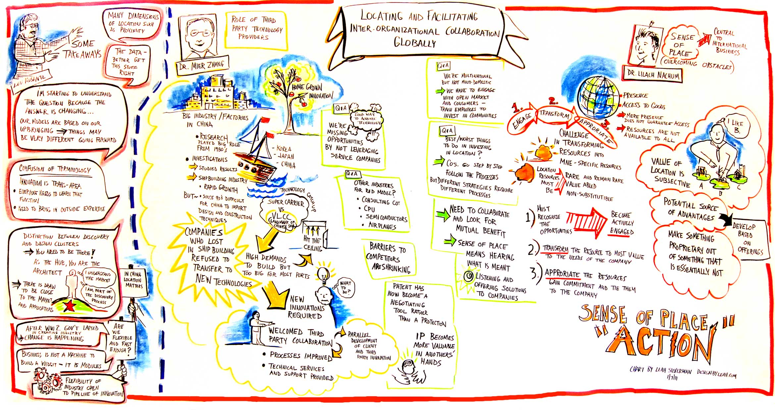

Slide 19
Does Location Still Matter for R&D?
Answer: Yes and No. It depends on where you sit!
Yes, for multinational enterprises, because location represents an opportunity to develop firm-specific capabilities for innovation by engaging and transforming local resources.
No, for home country competitors, because location as a barrier to catching up technologically and developing capabilities for innovation have shrunk dramatically (thanks to the existence of third party technology providers).

Slide 20
Knowledge Transfer and Competence Development in Multinational Corporations
Dr. Richard Kouri
Dr. Allen Black

Slide 21
Dr. Richard Kouri

Slide 22
Dr. Allen Black

Slide 24
Does Location Still Matter for R&D?
Answer: No and Yes.
No, when it comes to gathering competitive intelligence that drives the direction of a firm’s capabilities for innovation (by influencing choice of projects, partners, etc.). Powerful new IT tools search global information. Caveat: it may be important to bring domain experts face to face to make the best use of these tools – they only add value in proportion to the meaningfulness of the questions posed.
Yes, when it comes to the legal institutions (and cultural traditions) that affect opportunities to protect the intellectual property that is created through innovation. Cross jurisdictional differences that are not appreciated can result in tremendous lost value.

Slide 25
Collaborative Forum on Global Technology Innovation Does Location of R&D Matter Anymore? Workshop January 8, 2011
Charts by Leah Silverman

Slide 26
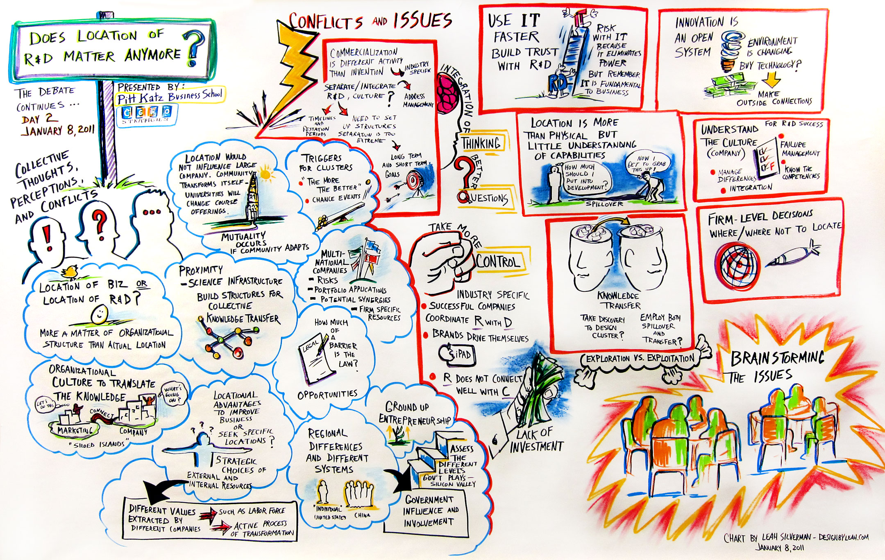

Slide 27
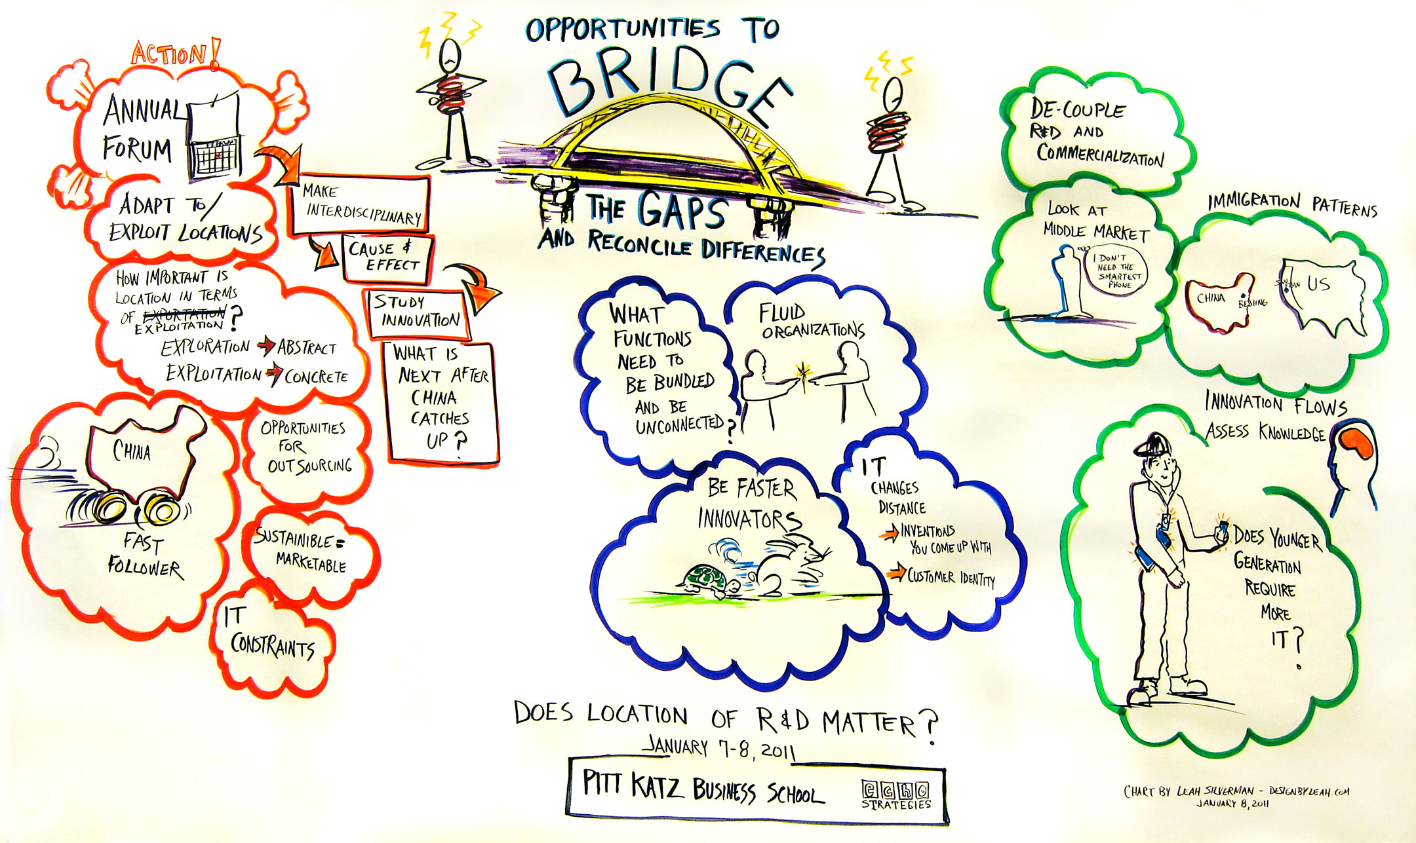

Slide 28
Does Location Still Matter for R&D?
Answer: Yes. But there is much we do not understand about how it matters.
We need to view the relationship between firm and location holistically and as a dynamic system. It is a relationship that co-evolves as firms invest in community resources and this in turn transforms the opportunities available to the firm. We need to understand the steps firms should take to develop firm-specific locational capabilities and how those will affect the kinds of innovation the region supports. We need to understand when differences in legal institutions present opportunities rather than threats.
We need to understand how differences in firm strategy affect the answers to this question. How does it matter whether a firm engages in largely exploitative or exploratory innovation? What about firms that seek to capture the middle market of technology users? We also need to better understand industry and technology differences that affect the nature of regional advantages that support innovation.
We need to understand how firms should organize to harvest and exploit knowledge and ideas sourced from different regions and different approaches to engaging a region, to sustain and enrich their innovation capabilities and we need to understand the role of IT in this. We need to understand how IT can be used more effectively to sustain global innovation capabilities.

